Slide 1
TZCF Variability revision

Slide 2
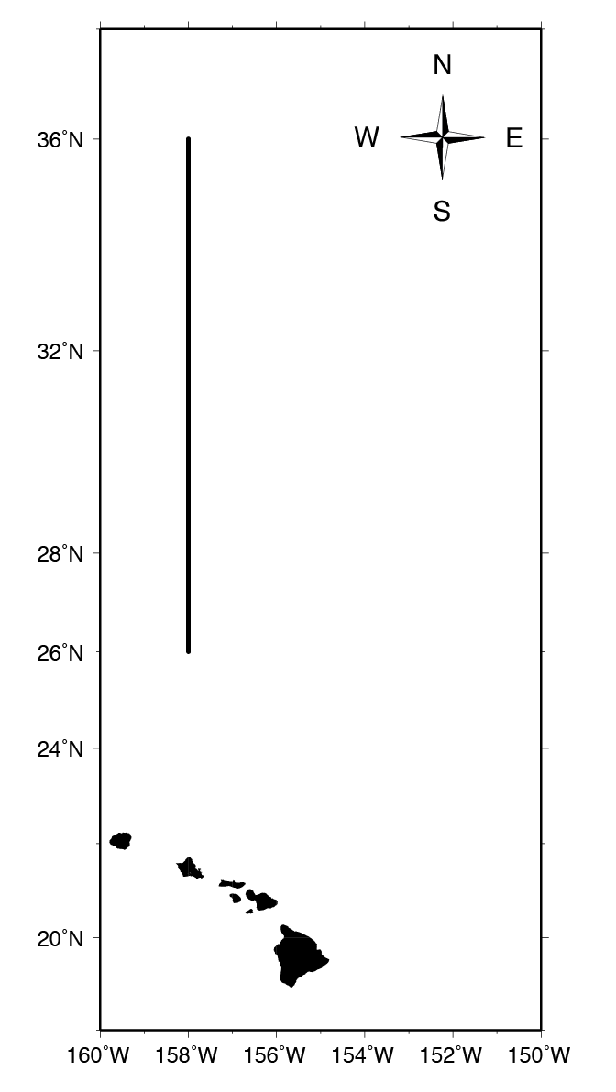
Figure 1
Figure 1. Map of the 2008, 2009, and 2001 transect lines used in this study

Slide 3
Table 1
Table 1. Oscar Elton Sette (SE) shipboard survey information for data used in this study with geographic boxes used to define frontal areas.
Cruise | Dates | Latitude | Longitude | Transect length | Frontal Positions
 |  |  |  | km [nmi] | STF | TZCF
SE-08-02 | 26 March-3 April 2008 | 26°00'-36°00'N | 158°00'W | 1111 [600] | 32°15'-32°45'N | 34°15'-35°45'N
SE-09-02 | 18 March-23 March 2009 | 26°00'-36°00'N | 158°00'W | 1111 [600] | 31°15'-32°15'N | 35°00'-36°00'N
SE-11-02 | 10 March-23 March 2011 | 26°00'-36°00'N | 158°00'W | 1111 [600] | 31°15'-32°15'N | 33°15'-34°15'N

Slide 4
Table 2. Phytoplankton Functional Types (PFTs) and Phytoplankton Size Classes (PSCs) represented by their pigments.
PFT | Diagnostic Pigments | Abbreviations | Estimation formula | PSC
Diatoms | Fucoxanthin | Fuco | 1.41[Fuco] | microplankton
Dinoflagellates | Peridinin | Perid | 1.41[Perid] | microplankton
Chromophytes and nanoflagellates | 19'-hexanoyloxyfucoxanthin | Hex-fuco | 1.27[Hex-fuco] | nanoplankton
Chromophytes and nanoflagellates | 19'-butanoyloxyfucoxanthin | But-fuco | 0.35[But-fuco] | nanoplankton
Cryptophytes | Alloxanthin | Allox | 0.60[Allox] | nanoplankton
Green flagellates and prochlorophytes | Total chlorophyll b | TChlb | 1.01[TChlb] | picoplankton
Cyanobacteria and prochlorophytes | Zeaxanthin | Zeax | 0.86[Zeax] | picoplankton

Slide 5
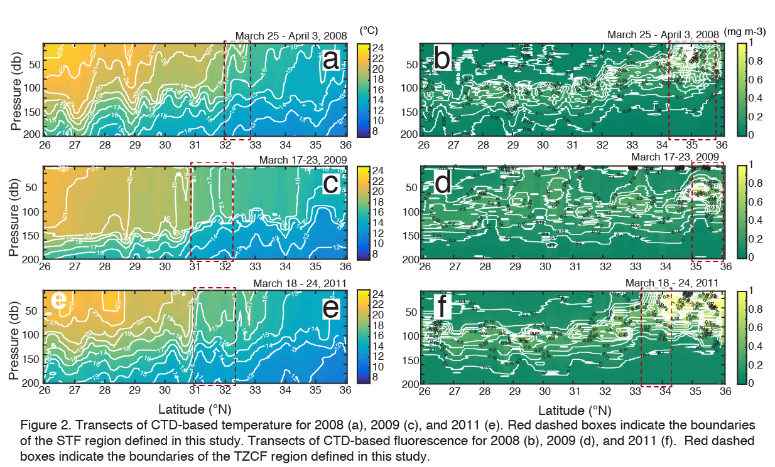
Figure 2

Slide 6
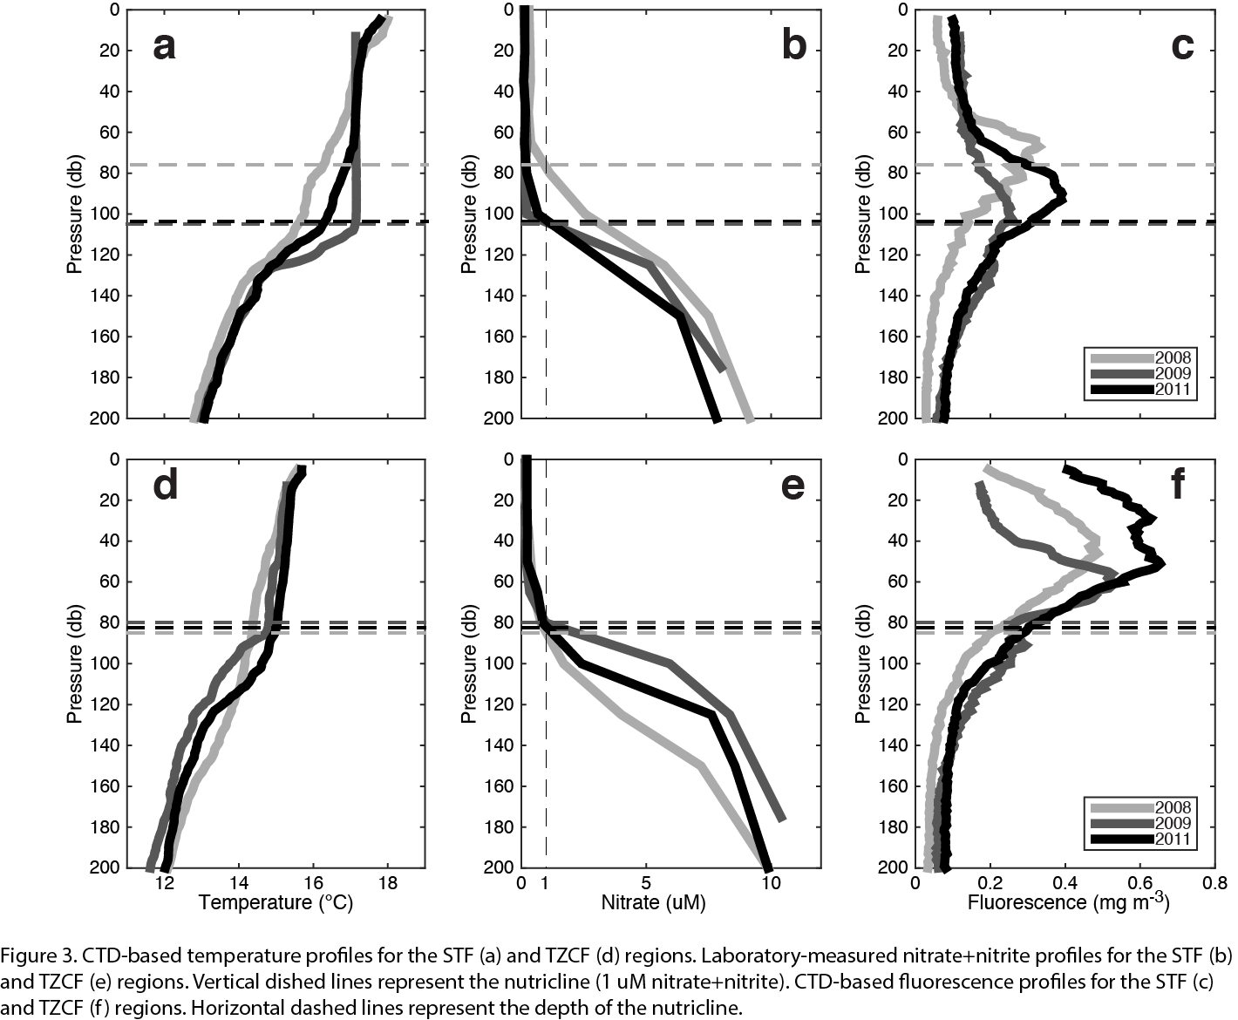
Figure 3
STFZ - Top
TZCF - bottom

Slide 7
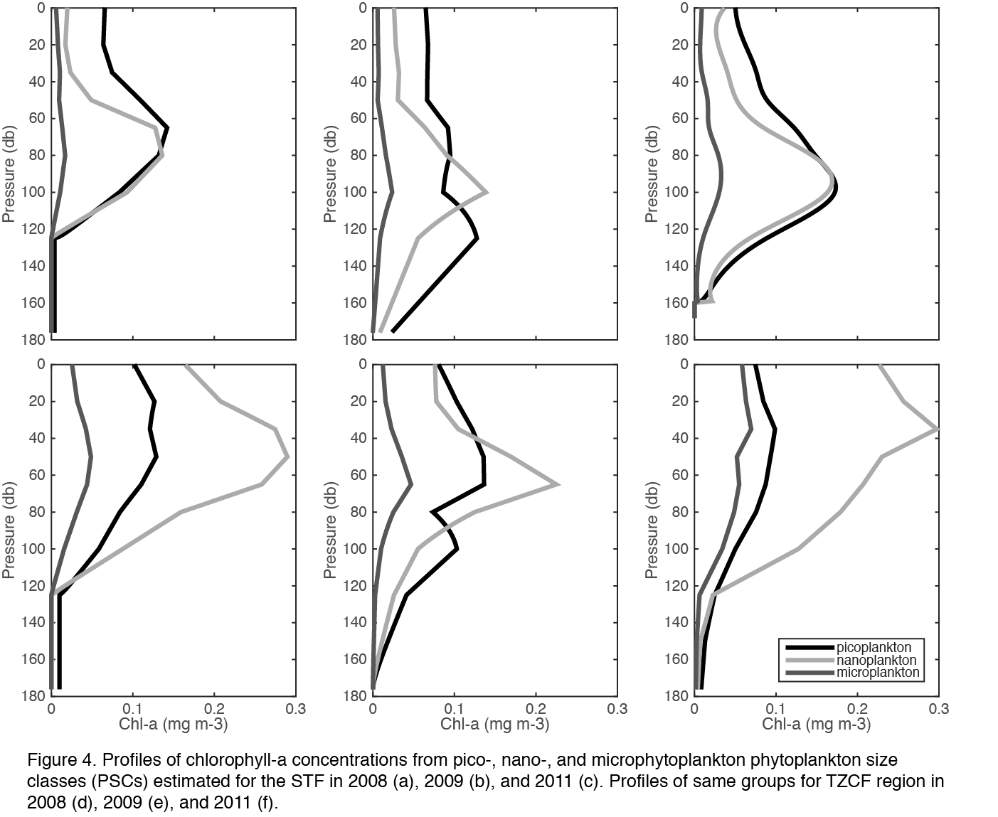
Fig 4

Slide 8
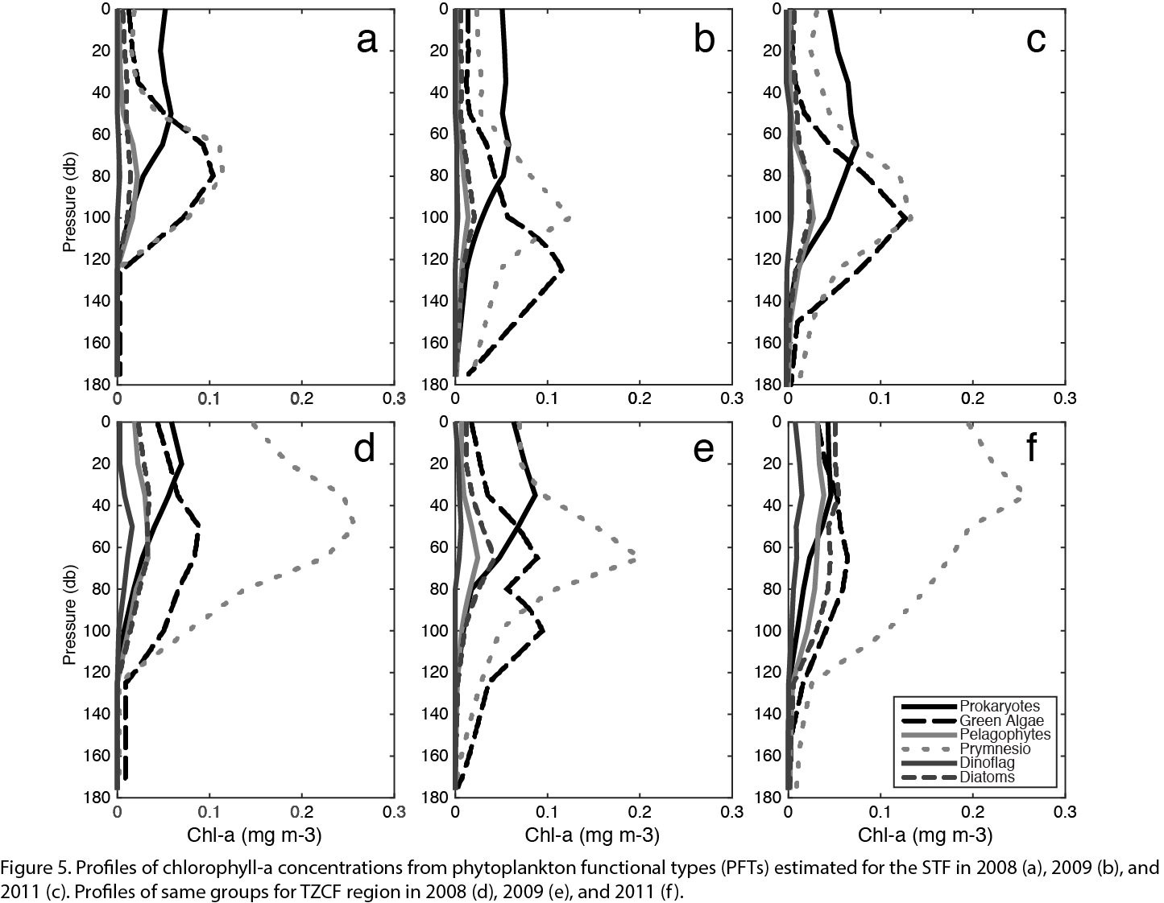
Fig 5

Slide 9
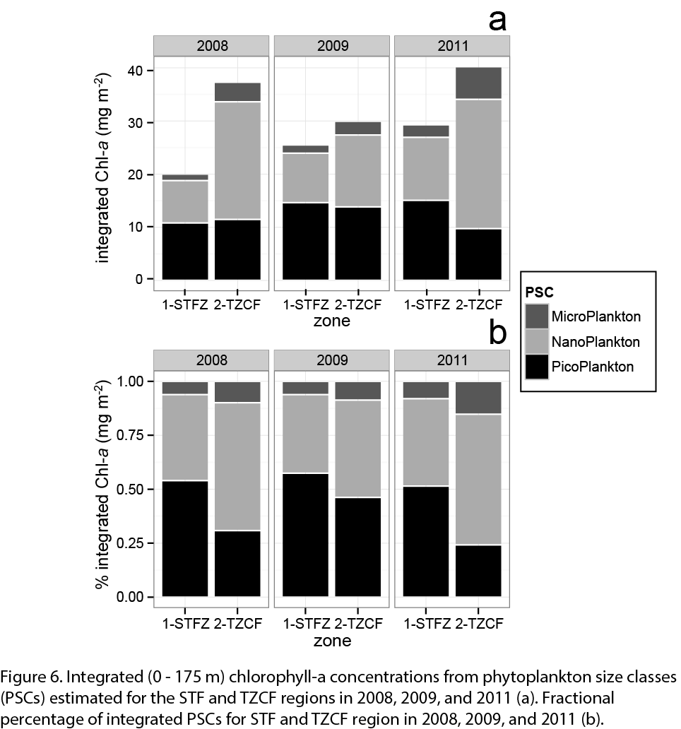
Fig 6

Slide 10
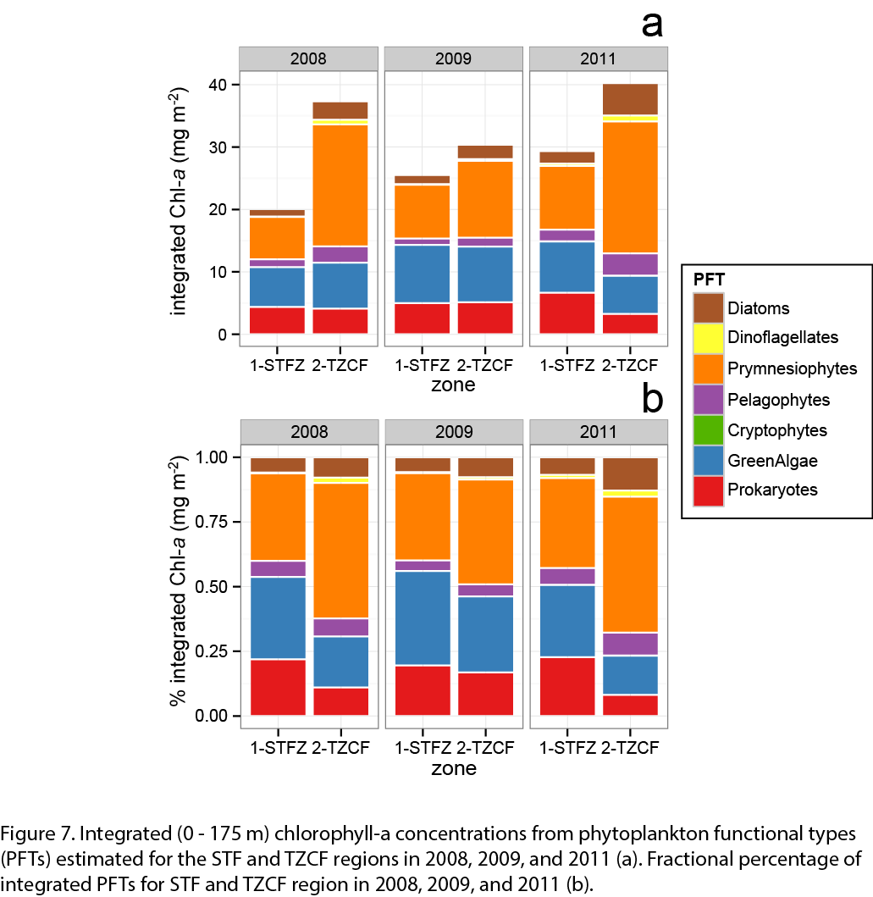
Fig 7

Slide 11
Table 3: 3-way ANOVA of PSC concentration
Table 3. Results of the analysis of PSC concentration using a 3-way ANOVA . Bold denotes significant results
Source | df | SS | F | p | sig. factor
Year | 1 | 13.1 | 1.586 | 0.24 | N.S.
Zone | 1 | 57 | 6.914 | 0.03 | *
PSC | 2 | 487.9 | 29.612 | <0.001 | ***
Year x Zone | 1 | 2.9 | 0.357 | 0.57 | N.S.
Zone x PSC | 2 | 108 | 6.555 | 0.02 | *
Year x PSC | 2 | 6 | 0.364 | 0.71 | N.S.
Residuals | 8 | 65.9
Signif. codes: 0 ‘***’ 0.001 ‘**’ 0.01 ‘*’ 0.05 ‘.’ 0.1 ‘ ’ N.S.

Slide 12
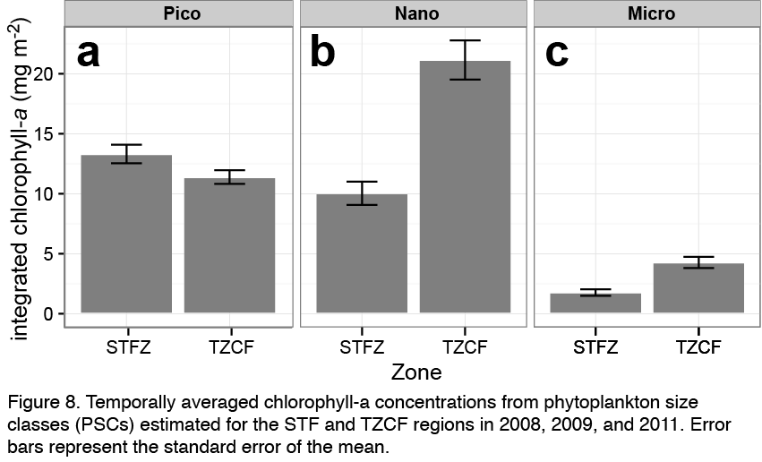
Fig 8 Comparing PSC and Zone to see why significant (Mostly Nano and Micro) (all years mean 0-175m)

Slide 13
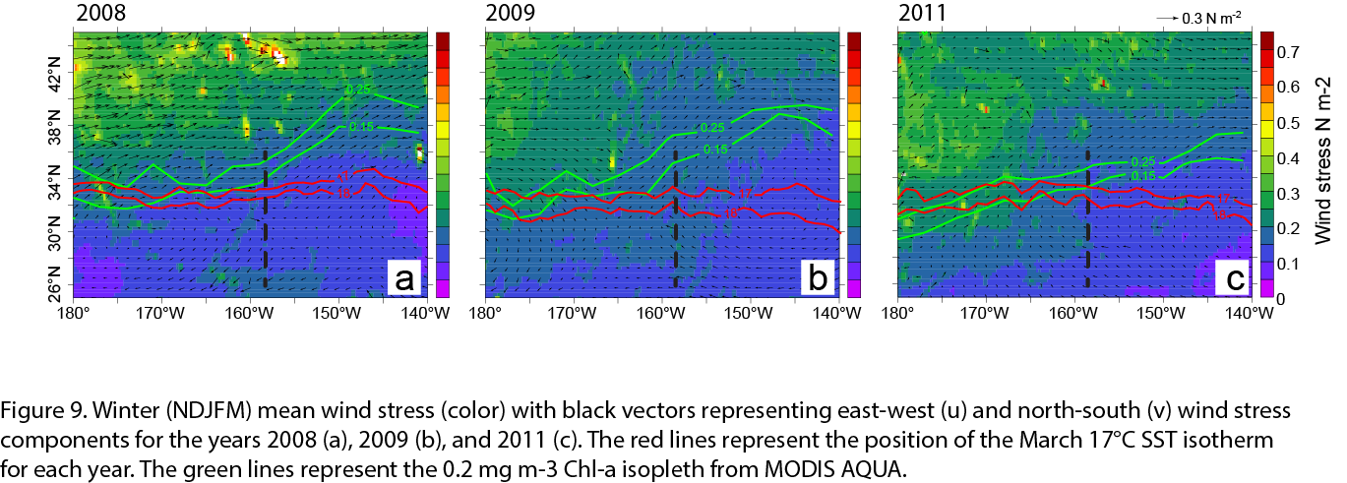
Fig 9 Show wind fields for Nov-Mar with Fronts at cruise? If we are going to discuss WHY we see things...

Slide 14
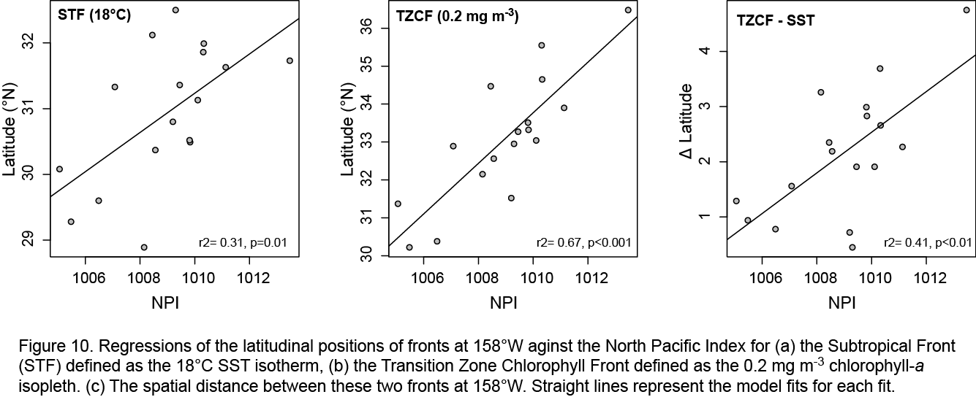
Fig 10 Could be table also but there is relationship between NPI (NDJFM wind) and position of TZCF in March. Less for temperature, so also less for difference

